Slide 1
Go over thesis and make sure you included all the stuff written there in each section here
Add refrences

Slide 2

Add TAU symbol
Show some sensitivity!
Using motion tracking to explore unconscious measures
Khen Heller under the supervision of Craig S. Chapman and Liad Mudrik

Slide 3



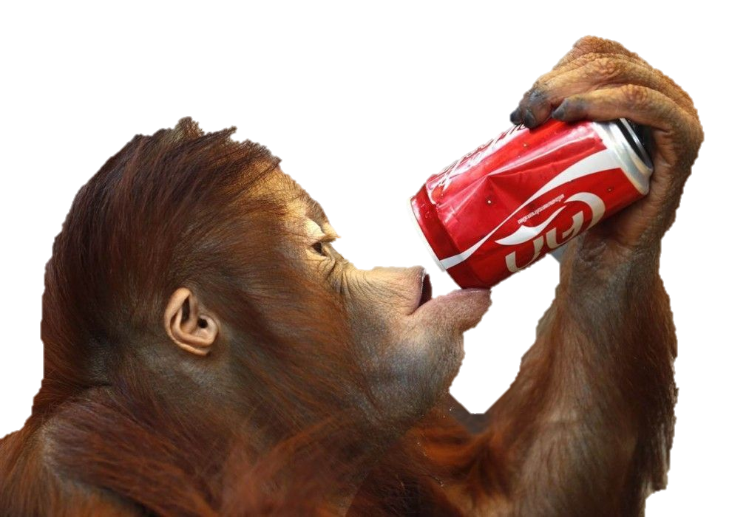
Un/conscious processing
Stimuli
Processing
Perceived?
Affects Behavior?
Conscious
Unconscious
Notes:
In day to day we our brain receives a lot of information
He than processes it.
Some of is consciously perceived, and thus called conscious
And as a result affects our behavior.
But we don’t perceive everything we processes,
Some of the information doesn’t enter our awareness,
But can still affect our behavior (references)
This is unconscious information

Slide 4

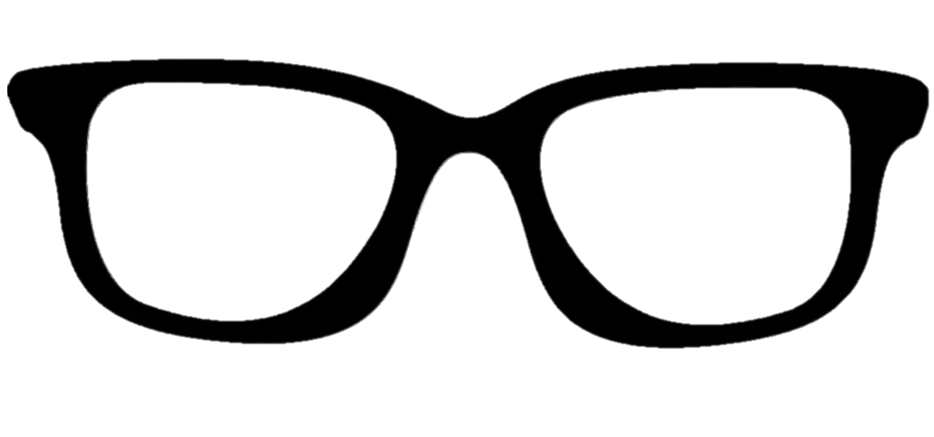
Unconscious processing
Stimuli
Processing
Perceived?
Affects Behavior?
Conscious
Unconscious
Degrading physical propeties
Supression by more salient stimuli
Diverting attention
Notes:
When one wants to research this type of information he can use 3 methods to render it UC:
degrading its physical propertis,
suppressing ti with more salient stimuli,
diverting attention.
All of which decreases visibility, but also decrease the neural response, → weaker behavioral change
How would one go about measuring the unconscious effect you ask? Well…

Slide 5
Measuring the Unconscious effect
Priming paradigm
RADIO
Time
radio
Natural / Artificial
Notes:
The most prominent method is the priming paradigm with a Keyboard RT measure.
A prime precedes the target, is rendered invisible, e.g. by masking with salient stimuli
Participant perform a task on the target, e.g. classify as artificial / natural.
Prime,target can be either congruent – evoke the same response.

Slide 6
Measuring the Unconscious effect
Priming paradigm
CLOUD
radio
Subjective Objective
Time
How well did you see the first stimuli?
On a scale of 1-4
Natural / Artificial
CLOUD / RIVER
1 2 3 4
Notes:
Or incongruent – evoke opposite responses.
To verify that prime is indeed invisible, two types of measures are available:
Subjective – participant asked about his experience of the prime.
Objective – participant is asked to perform a judgment about the prime, and the invisibility is inferred from low accuracy..

Slide 7
Measuring the Unconscious effect
Priming paradigm
CLOUD
Congruency effect
Time
radio
RT
Natural / Artificial
Congruent
Incongruent
Notes:
To Measure the effect we compare the RT between the conditions and that difference gives us the congruency effect.
It implies that the prime was unconsciously processed.
Problem is this effect is usually very small when recorded with a keyboard (add references)

Slide 8
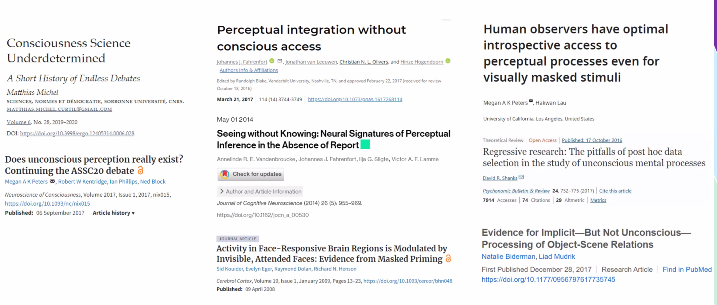




Consequences of Low Sensitivity
Problem: Common measure can’t pick up the effect
Consequence: controversy
Explanation: Underestimation of the effect
Solution: Increase sensitivity
Congruency effect
RT
Congruent
Incongruent
Notes:
The problem with a small effect is that it is hard to detect,
Which leads to contradicting findings (references)
that in turn evoke controversy on the scope of UC processing. (references)
Some say:
Unconscious processing can perform high level functions and have a small but existing affect on behavior, (references)
Others say:
It is negligible, and the parts of it that can be found can be explained by conscious influence. (references)
You could say:
One explanation that can account for the contradicting findings is uncderestimation of the UC effect
And the solution for this could be to use more sensitive measure that would capture a largir effect due to insensitive measures

Slide 9
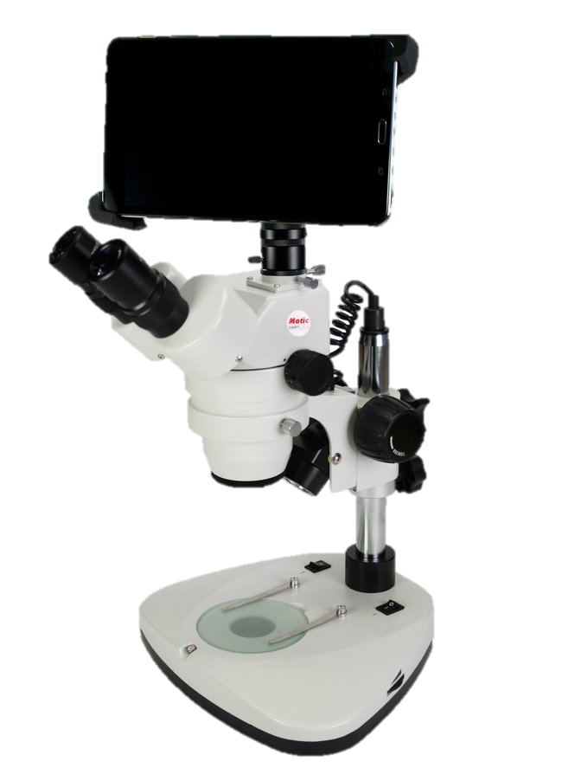
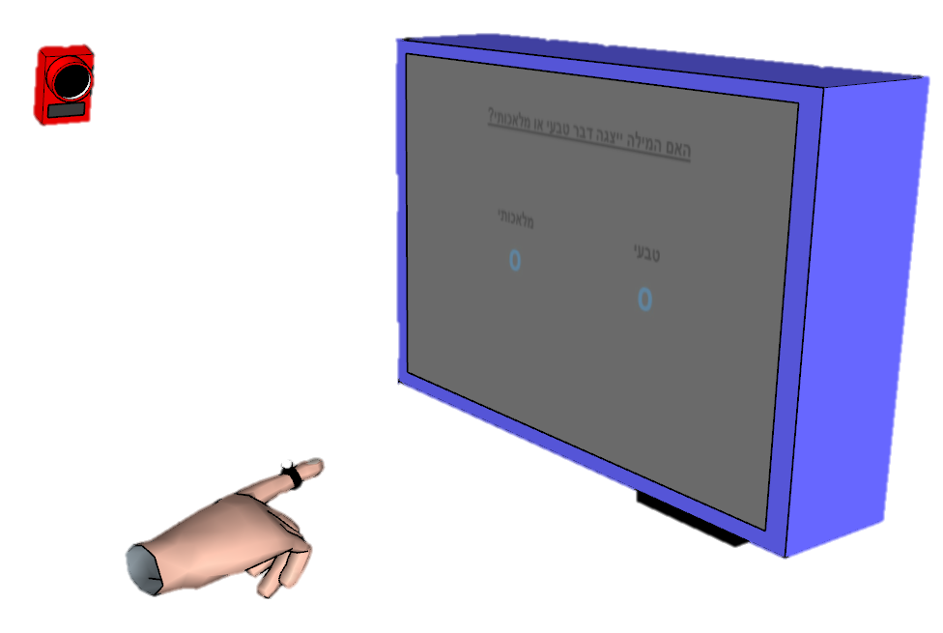
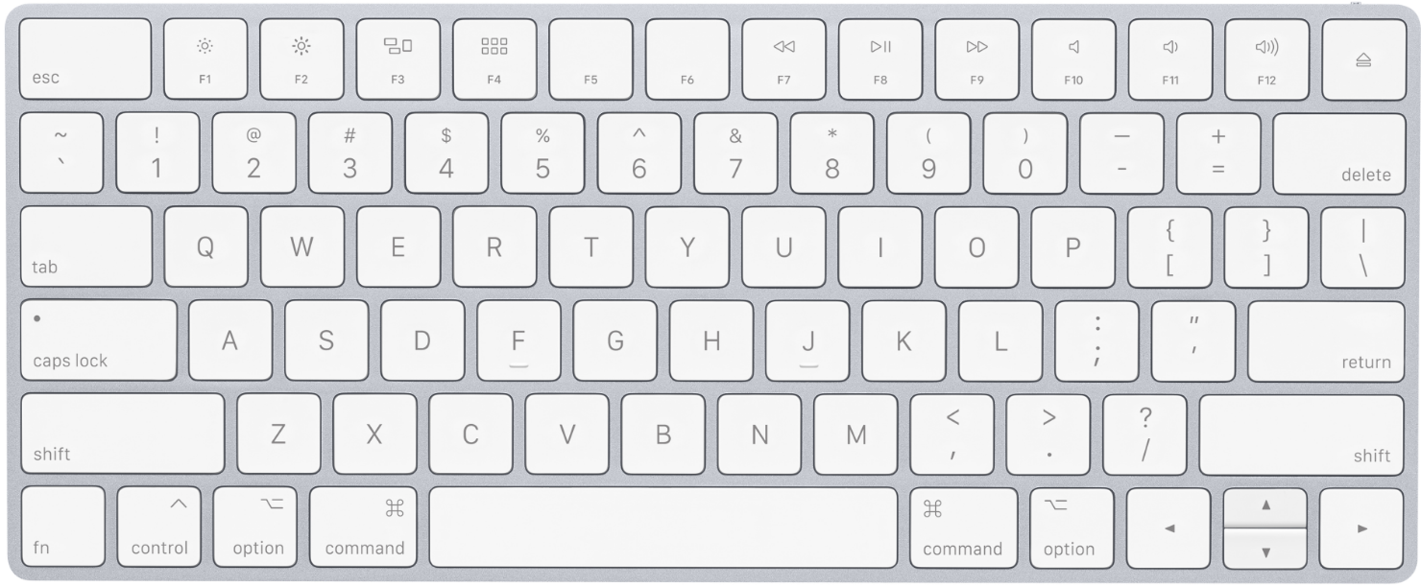
Improving Sensitivity
Single value
Post decision
“Poor” – RT, accuracy
Continuous
Online
“Rich” – RT, onset, MAD, velocity…
Notes:
One option for improving sensitivity is to use motion tracking,
Which has become a popular tool for probing unconscious effects. (references)
This tool has three main advantages over the usual keyboard response measure:
(references)
Continuous – more suitable for ongoing cognitive processes
Rich – allows to capture effect which aren’t detectable in other parameters of the response.

Slide 10
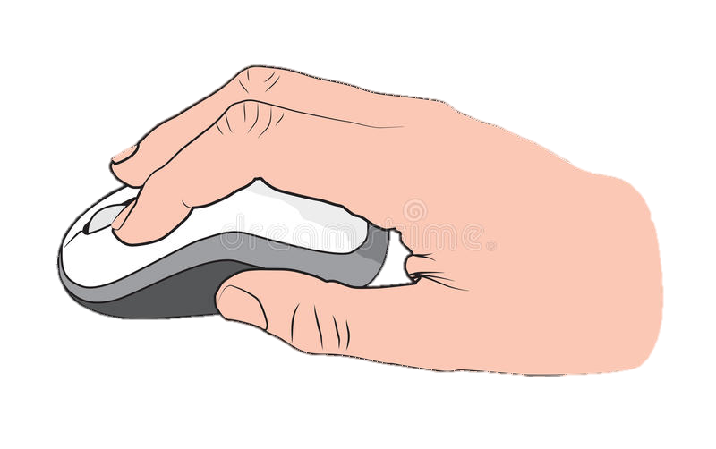
Xiao et al (2015)
Time
3 \ 3
Same / Different
VS
t(35) = 1.92, p = 0.06, d = 0.65, CI_{d} [0.16, 1.14] t(27) = 5.13, p < 0.001, d = 1.97, CI_{d} [1.31, 2.64]
Notes:
To date,
Only one study directly compared them (reference)
Importantly, it found a robust weffect when using mouse tracking,
While the keyboard effect was only marginally significant.

Slide 11
Xiao et al (2015), Limitations
Cavities: Common measure can’t pick up the effect
Consequence: controversy
Explanation: Underestimation of the effect
Solution: Increase sensitivity
t(35) = 1.92, p = 0.06, d = 0.65, CI_{d} [0.16, 1.14] t(27) = 5.13, p < 0.001, d = 1.97, CI_{d} [1.31, 2.64]
Notes:
To date,
Only one study directly compared them (reference)
Importantly, it found a robust weffect when using mouse tracking,
While the keyboard effect was only marginally significant.

Slide 12
Is motion better than keyboard? Only one study
Bad awareness measure
mOuse tracking less sensitive then reaching

Slide 13
Current study
Rigorous awareness measure
Reaching

Slide 14
Three exploratory studies, one confirmatory

Slide 15
Study 1
Paradigm
Setup
Extracted variables
Results
RT too long -> non siongificnat effect

Slide 16
Study 2
Shorter RT
Results
Deviant participant – show results without him
Too quick, many excluded trials -> reduces SNR

Slide 17
Study 3
Training day
Results – showing some ra effect
Small decrease in RT, but Increase in excluded trials – they might t ask why this happened

Slide 18
Study 4
No training day
Includes both measures
Estimation of necessary num of trials to get an effect – half of the trials.
Results – significant effects
Significance, criticism about awareness ins’t relevant.
Increases num of correct answers
Expressed thorought the traj – how did you infer the time? Since traj is normalized.
Less valid trials in motion, but more correct
Effect size comparison
Discrepency with Xiao
Mouse more sensitive than reach
AUC as opposed to reach area – show analysis
Awareness measure – Xiao stems from aware participants
Accidental finding – future studies use dynamic starting condition.
Advantages
Decreases invalid trials
Noise keyboard VS reach
Short lived nature of UC effects
Heading angle
X STD

Slide 19
Jason might ask about changing the onset of subject movement to better delineate the timecourse of the UC effect.

